Slide 1

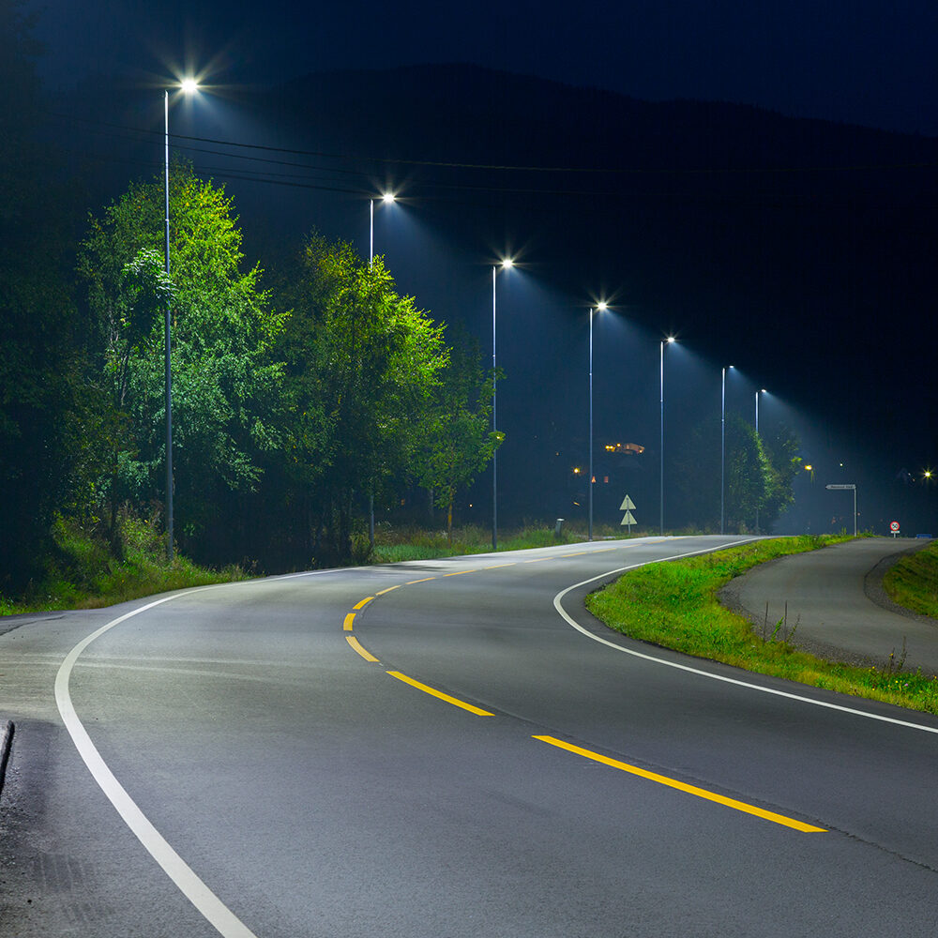
Smart Street Lighting
S Harshitha 22R11A05D5
P Varshita 22R11A05D0
CSE - C
3rd Year 1st Semester
Innovative solutions for cities

Slide 2

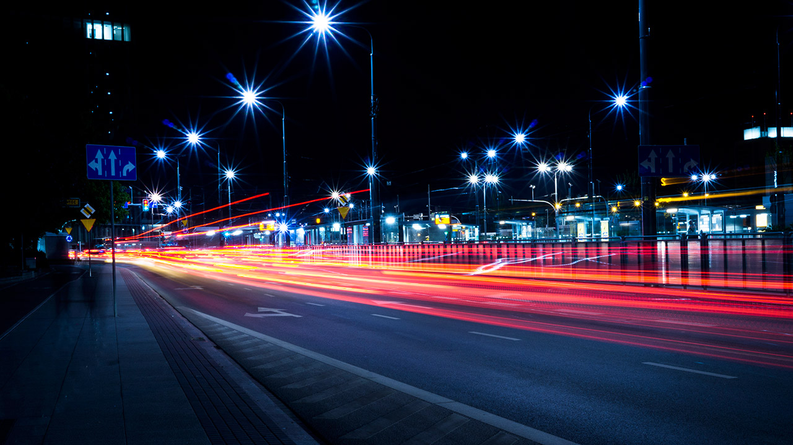

Introduction to smart street lighting
.The street lighting is one of the largest energy expenses for a city.
.An intelligent street lighting system can cut municipal street lighting costs as much as 50% - 70%.
. The energy consumption in entire world is increasing at the fastest rates due to population growth and economic development and the availability of energy sources remains woefully constrained.

Slide 3



Existing System
Street lights remain always on when there is presence of light.
These street lights need a manual switching operation.
It also needs man power.
These street lights are unnecessarily glowing with its full intensity in the absence of any activities in the street.
High power consumption and waste of energy.

Slide 4



Proposed System
Automatic Switching of Street lights.
Maintenance Cost Reduction.
Reduction in CO₂ emission. Reduction of light pollution. Energy Saving.
Reduction of manpower.

Slide 5
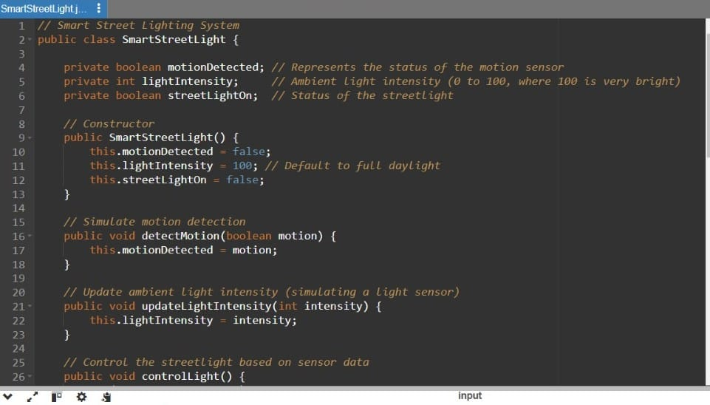

Slide 6
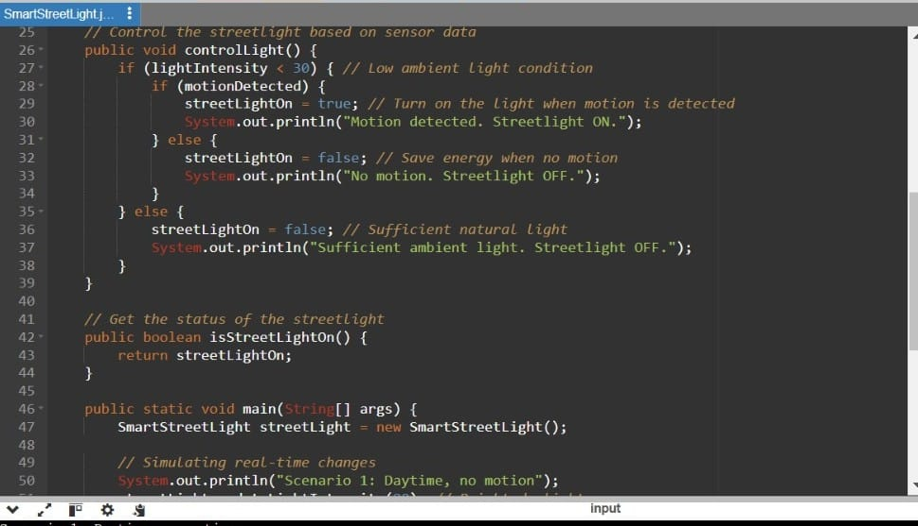

Slide 7
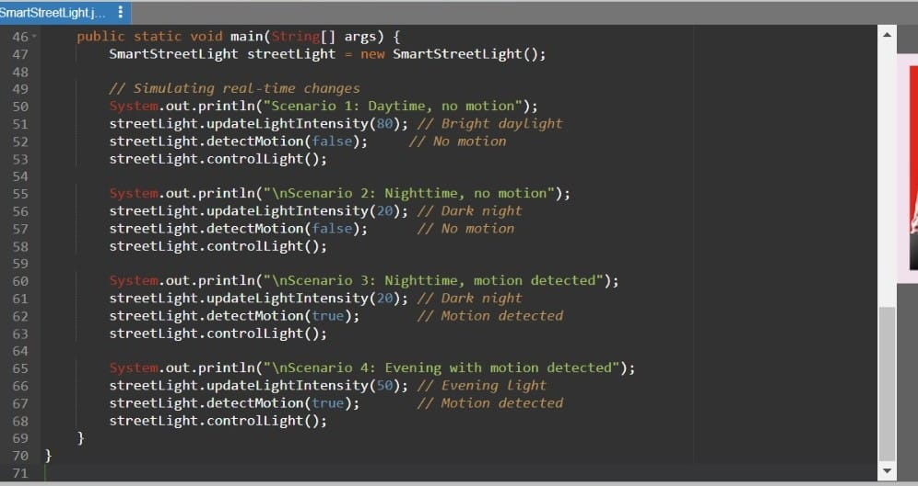

Slide 8
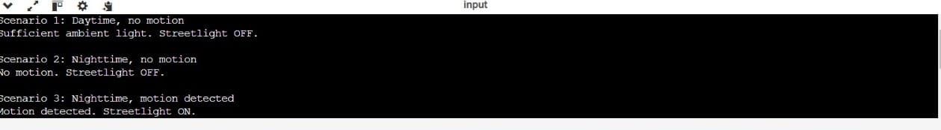
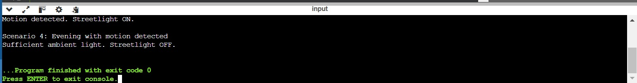
Output

Slide 9
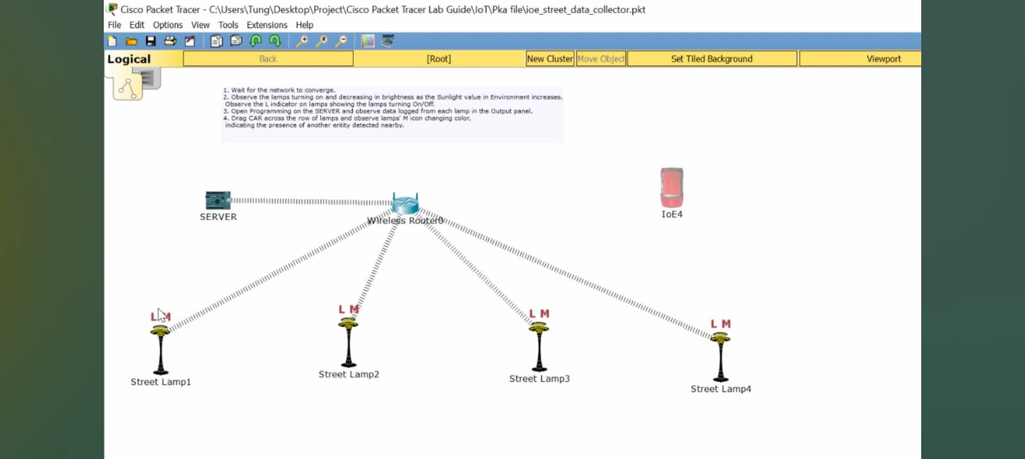
Cisco Packet Tracer

Slide 10
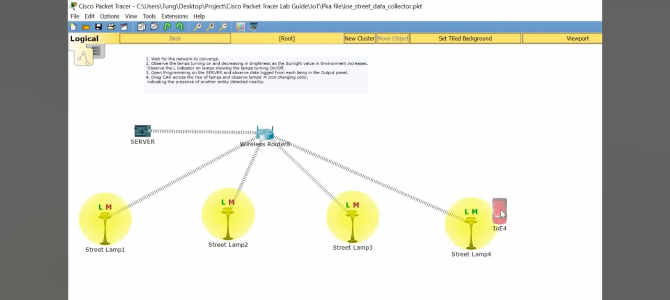
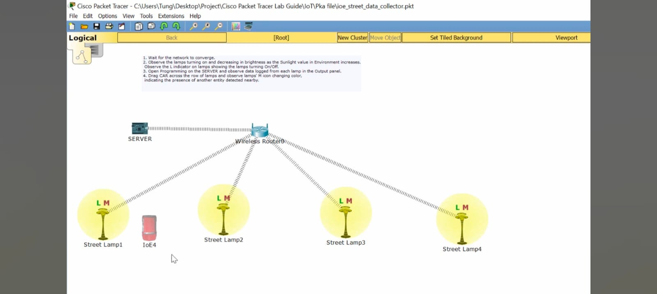

Slide 11
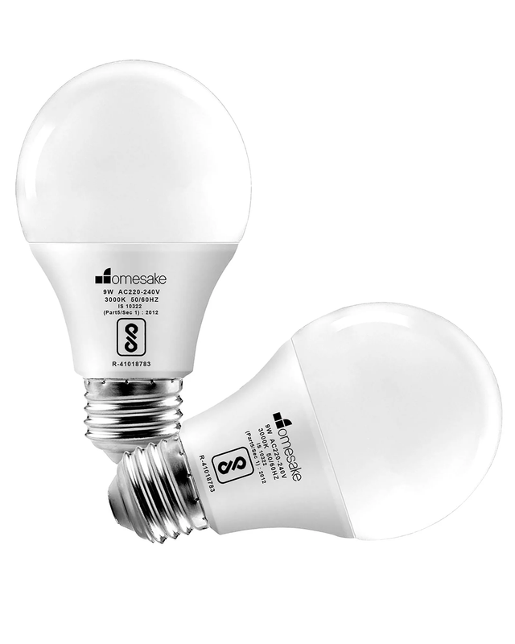

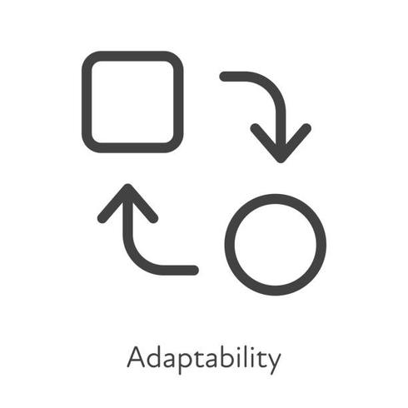
Smart Lighting Technology
Energy-efficient lighting
Real-time management
Dynamic illumination
Saves energy and reduces operational costs.
Monitors performance and improves maintenance efficiency.
Adjusts brightness based on surrounding conditions.

Slide 12



Objectives
Energy Saving.
Longer life expectancy.
To avoid unnecessary Waste of light.
Provide efficient, automatic and smart lighting system.
Totally based on Renewable energy sources.

Slide 13



Conclusion
This Smart Street lighting system not only helps in rural areas but also beneficial in urban areas too. As we are moving towards more advancement we require more power so use of renewable resources is useful and advantageous. With this project, we can even add smart parking of vehicle and it is even useful for driverless cars.With the advances in technology and good resource planning the cost of the system can be cut down and also with the use of good equipment the maintenance can also be reduced in terms of periodic checks.

Slide 14
THANK YOU!!
“Illuminate the path
to a brighter, sustainable
future together.”

